Slide 1
Electronic Devices
Mid Term Lecture - 03
Faculty Name: Dr. Mohammad Alif Arman
Email : dr.alifarman@aiub.edu
Room: DN0526
Reference book:
Electronic Devices and Circuit Theory (Chapter-2)
Robert L. Boylestad and L. Nashelsky , (11th Edition)

Slide 2
Objectives
Understand the concept of load-line analysis and how it is applied to diode networks.
Become familiar with the use of equivalent circuits to analyze series, parallel, and series-parallel diode networks.

Slide 3
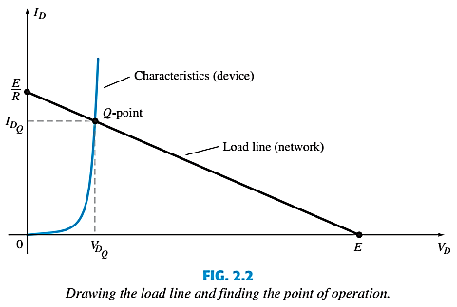
LOAD-LINE ANALYSIS
A load line is a line drawn on the IV characteristics curve.
The load line plots all possible combinations of diode current (I_{D}) and voltage (V_{D}) for a given circuit.
The maximum I_{D} equals E/R, and the maximum V_{D} equals E.
The point where the load line and the characteristic curve intersect is the Q-point, which identifies I_{D} and V_{D} for a particular diode in a given circuit.

Slide 4

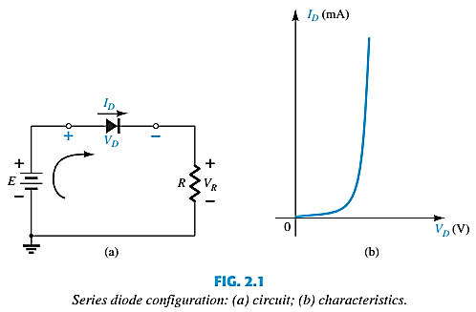
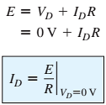
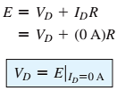
LOAD-LINE ANALYSIS

Slide 5
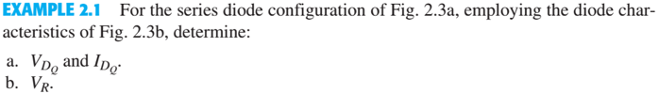
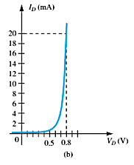
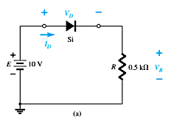
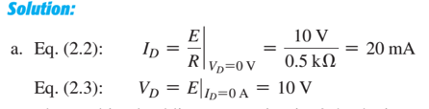
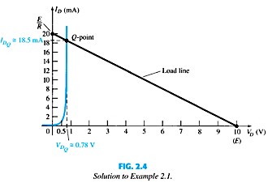

LOAD-LINE ANALYSIS

Slide 6

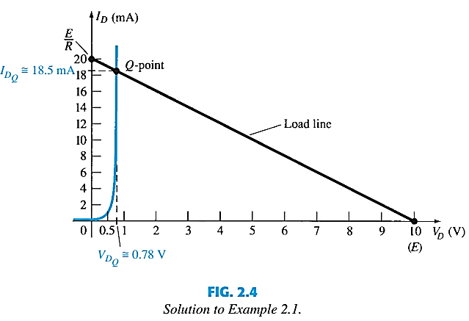
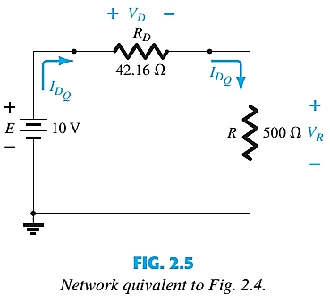
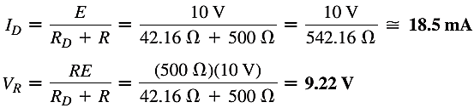
LOAD-LINE ANALYSIS

Slide 7
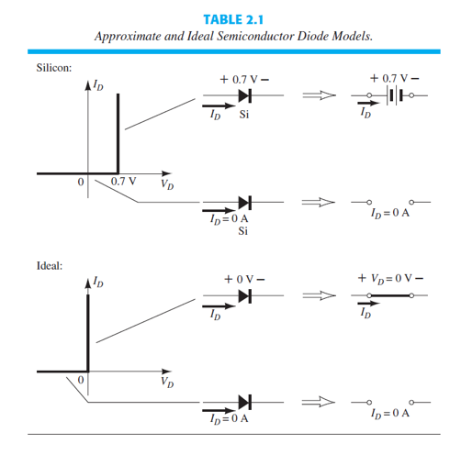
SERIES DIODE CONFIGURATIONS

Slide 8
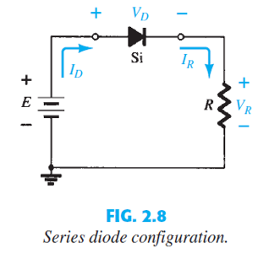
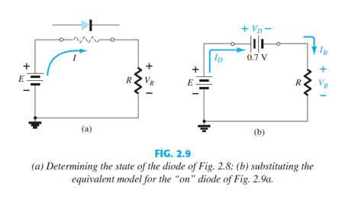
SERIES DIODE CONFIGURATIONS
Replace with equivalent Circuit

Slide 9
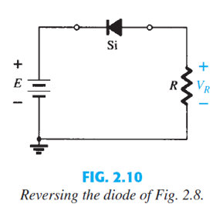
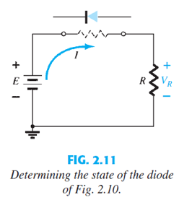
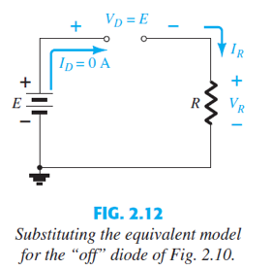
SERIES DIODE CONFIGURATIONS
Replace with equivalent Circuit

Slide 10
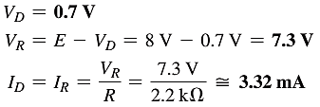
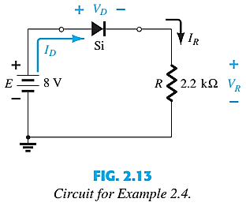
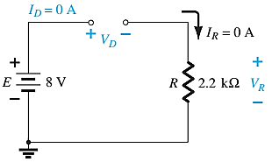

SERIES DIODE CONFIGURATIONS

Slide 11

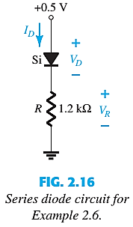
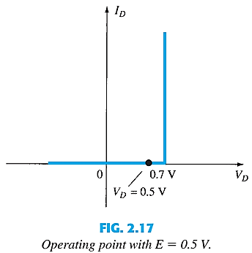
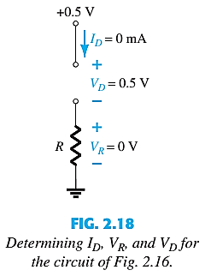
SERIES DIODE CONFIGURATIONS

Slide 12
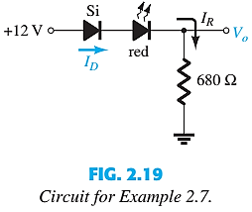
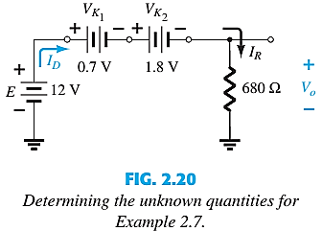

SERIES DIODE CONFIGURATIONS

Slide 13
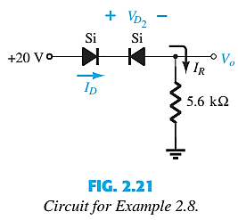
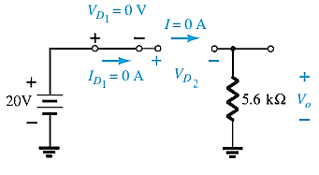

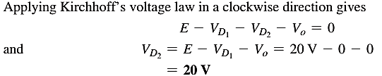
SERIES DIODE CONFIGURATIONS

Slide 14
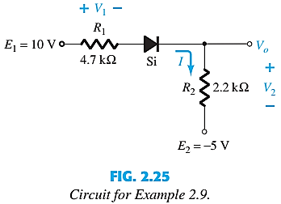
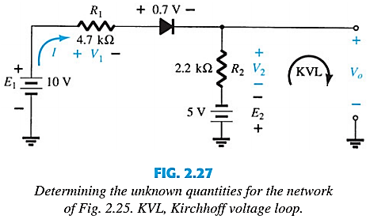



SERIES DIODE CONFIGURATIONS
Applying KVL,

Slide 15
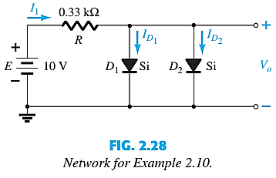
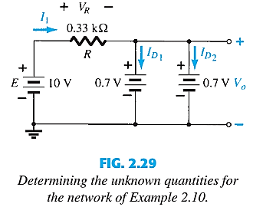



SERIES-PARALLEL CONFIGURATIONS
See Example 2.11

Slide 16
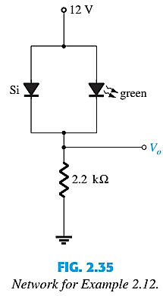
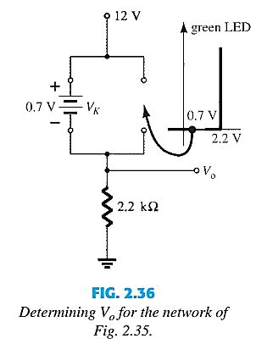

SERIES-PARALLEL CONFIGURATIONS

Slide 17
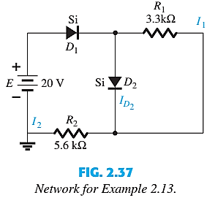
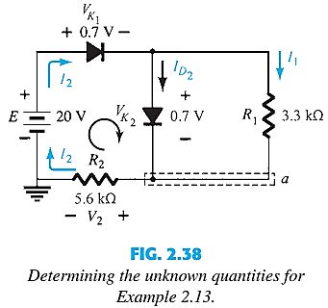

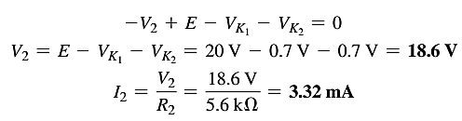

SERIES-PARALLEL CONFIGURATIONS
See Example 2.14 and 2.15

Slide 18
Thank You

